Slide 1

Software Architecture
Designing the Blueprint for Scalable Systems
Ing. Jonathan Solis Parajeles / ITCR

Slide 2
What is Software Architecture?
The high-level structure of a software system: its components, their relationships, and the principles that guide its design and evolution.
Captures the significant decisions that are expensive to change later.
Acts as a shared blueprint that aligns developers, architects, and stakeholders.
Bridges business goals and technical implementation.

Slide 3
Why It Matters
Ensures scalability, maintainability, and performance from the start.
Guides development teams and aligns stakeholders around a common vision.
Reduces long-term cost by avoiding ad-hoc, hard-to-reverse decisions.
Makes quality attributes such as security and reliability explicit and testable.

Slide 4
Core Architectural Styles
Layered (n-tier) – organizes the system into UI, business logic, and data tiers.
Microservices – independent, loosely coupled services deployed separately.
Event-Driven – components react asynchronously to events and messages.
Client-Server – a central server provides resources to multiple clients.

Slide 5
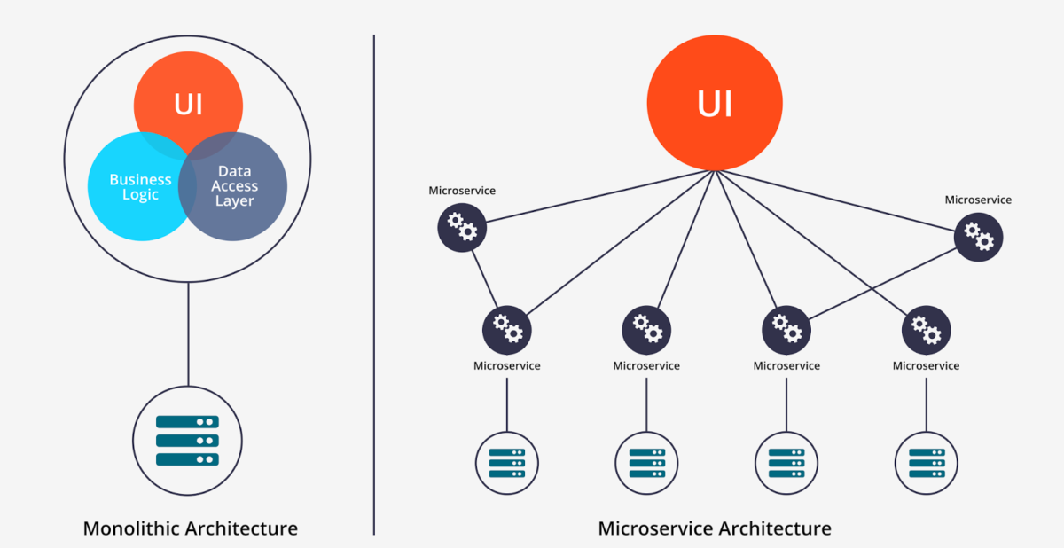
Monolithic vs Microservices

Slide 6
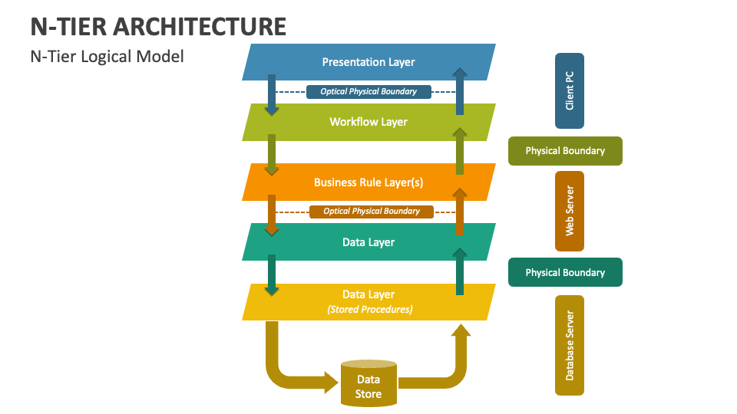
Layered
(n-tier)

Slide 7
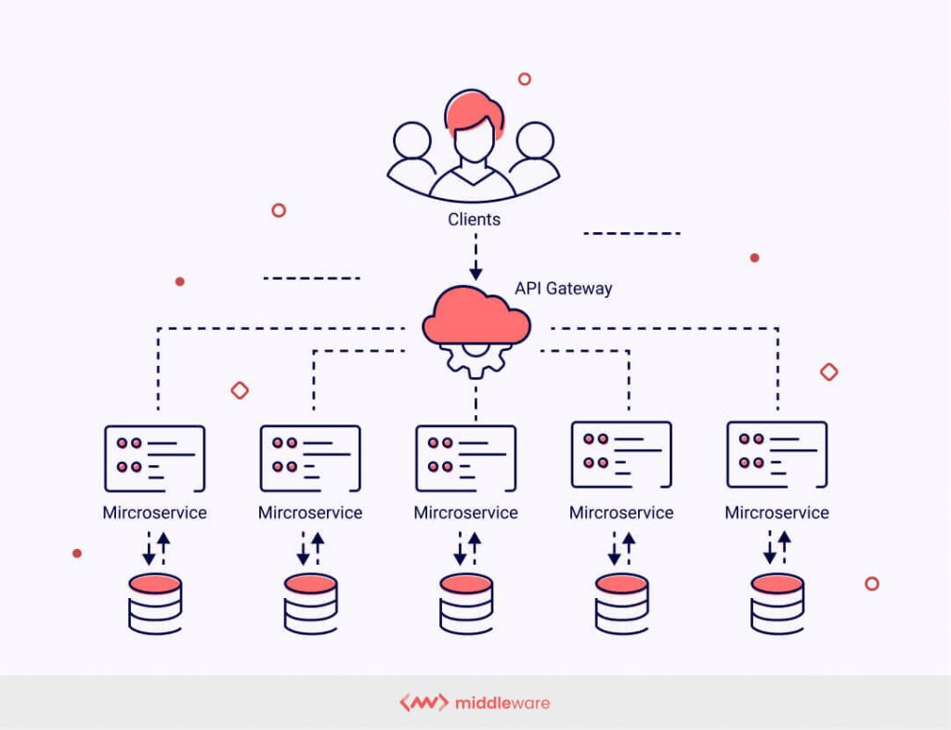
Microservices

Slide 8
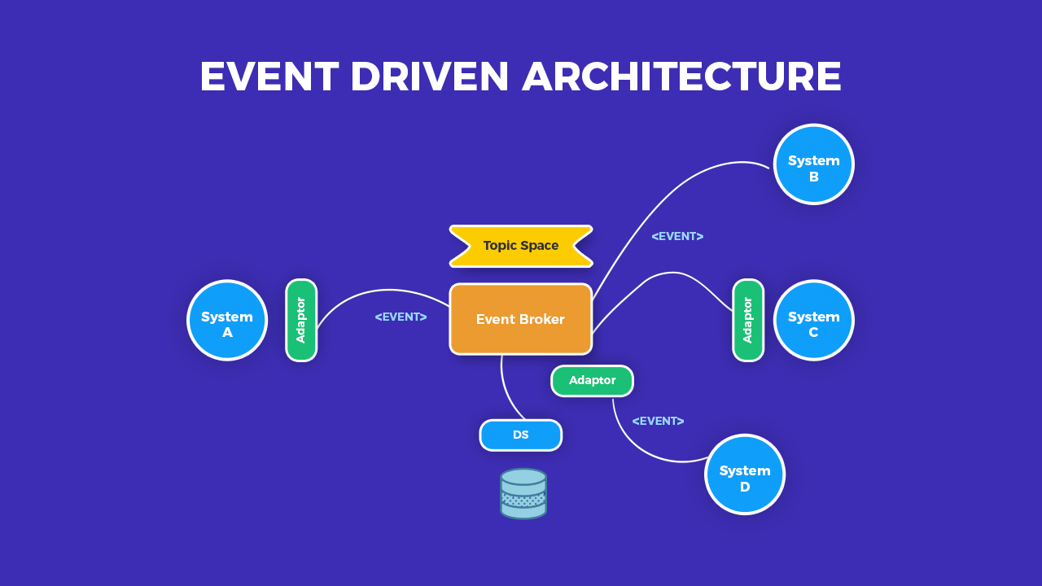
Event-Driven

Slide 9
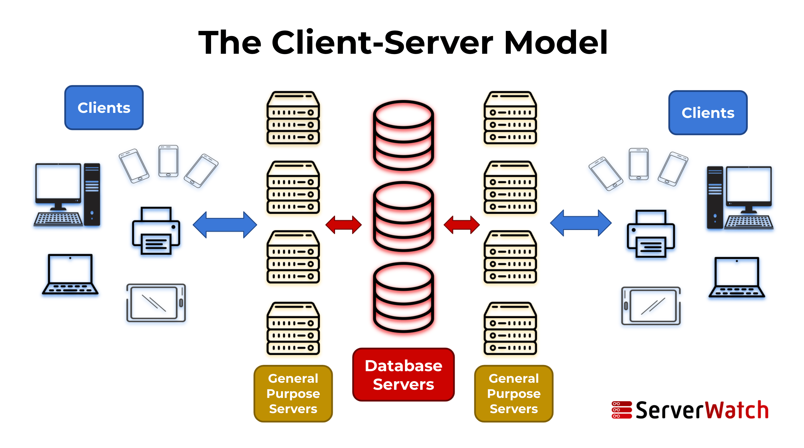
Client-Server

Slide 10
Key Components & Connectors
Components: modules, services, databases, and APIs that carry responsibility.
Connectors: protocols, message queues, and service buses that link them.
Configuration: how components and connectors are arranged at runtime.
Clear interfaces keep components replaceable and loosely coupled.

Slide 11
Quality Attributes
Performance – response time and throughput under expected load.
Security – authentication, authorization, and encryption.
Scalability – horizontal and vertical scaling to meet demand.
Maintainability – ease of updating, testing, and debugging over time.

Slide 12
Architectural Styles & Patterns
A style is a broad, system-wide way of organizing components (layered, microservices, event-driven).
A pattern is a reusable solution to a recurring design problem within that style.
Styles set the overall shape; patterns solve concrete structural concerns.
Well-chosen patterns realize the quality attributes a style promises.

Slide 13
Common Architectural Patterns
MVC / MVVM – separate presentation, logic, and state.
Microkernel (plug-in) – a minimal core extended by add-on modules.
Pipes & Filters – process data through a chain of independent stages.
CQRS & Event Sourcing – split reads from writes; store state as events.
Broker / Publish-Subscribe – decouple senders and receivers via a mediator.

Slide 14
Technology Trends in Software Architecture
Cloud-native & serverless – elastic, managed, event-driven compute.
Containers & Kubernetes – portable packaging and automated orchestration.
Microservices & service mesh – fine-grained services with managed communication.
Edge computing & real-time streaming – processing closer to data, as it happens.
AI-assisted architecture – copilots and LLMs supporting design and operations.

Slide 15
Enterprise Application Architecture
Structures large-scale business systems that span many users, processes, and data sources.
Organized into four domains: business, application, data, and technology.
Guided by frameworks such as TOGAF and the Zachman Framework.
Aligns IT capabilities with enterprise strategy and governance.

Slide 16
Enterprise Integration & Patterns
Multi-tier (n-tier) – presentation, application, and data tiers at enterprise scale.
SOA & ESB – reusable services integrated through an enterprise service bus.
API-led connectivity – layered system, process, and experience APIs.
Domain-Driven Design – model complex domains around bounded contexts.
Emphasis on security, transactions, and high availability.

Slide 17
Tools & Frameworks
UML, ArchiMate, and PlantUML for modeling and diagrams.
The C4 model for communicating architecture at different levels.
Cloud architecture tools (AWS, Azure, GCP) for design and provisioning.
CI/CD pipelines and fitness functions to validate architecture continuously.

Slide 18
For The Road
Go to the Microsoft Azure Portal.
Log in using your TEC account.
Validate that you have enough credits.
Explore and experiment with the services.

Slide 19
Best Practices Reading
“Best Practices in Software Architecture for Scalable, Secure, and Maintainable Systems” – DEV Community.
“Software Architecture Design Best Practices You Should Know.”

Slide 20
Thank You

